Slide 1
DIVE INTO THE WEB
Fii Practic - Session 3

Slide 2
Agenda
HTTP Protocol Highlights
HTTP Protocol Status Codes
HTTP Verbs
Spring MVC
JSON vs XML
REST API

Slide 3
HTTP highlights

Slide 4
HTTP
Details
The Hypertext Transfer Protocol is an application-level protocol for distributed, collaborative, hypermedia information systems.
This is the foundation for data communication for the World Wide Web
HTTP is a communication protocol, which is used to deliver data HTML files, image files, queries on the World Wide Web.
The default port is TCP 80, but other ports can be used.
It provides a standardized way for computers to communicate with each other.
HTTP specification specifies how clients request data will be constructed and sent to the serve, and how servers respond to these requests.

Slide 5
HTTP
Features
HTTP Is connectionless: The HTTP client (ie. browser) initiates an HTTP request and after a request is made, the client disconnects from the server and waits for a response. The server process the request and re-establish the connection with the client to send response back.
HTTP is media independent: This means, any type of data can be sent by HTTP as long as both the client and server know how to handle the data content. This is required for client as well as server to specify the content type using appropriate MIME-type.

Slide 6
HTTP
Features
HTTP is stateless: As mentioned in the previous slide, HTTP is a connectionless and this is a direct result that HTTP is a stateless protocol. The server and client are aware of each other only during a current request. Afterwards, both of them forget about each other. Due to this nature of the protocol, neither the client nor the browser can retain information between different request across the web pages.
HTTP/1.0 uses a new connection for each request/response exchange
HTTP/1.1 connection may be used for one or more request/response exchanges.

Slide 7
HTTP
What can be controlled by HTTP?
Caching
How documents are cached can be controlled by HTTP. The server can instruct proxies and clients, about what to cache and for how long. The performance of web sites and applications can be significantly improved by reusing previously fetched resources.
Authentication
Some pages may be protected so that only specific users can access them. Basic authentication may be provided by HTTP, either using the WWW-Authenticate and similar headers, or by setting a specific session using HTTP cookies.

Slide 8
HTTP
What can be controlled by HTTP?
Proxy and tunneling
Servers or clients are often located on intranets and hide their true IP address from other computers. HTTP requests then go through proxies to cross this network barrier. Not all proxies are HTTP proxies. The SOCKS protocol, for example, operates at a lower level. Other protocols, like ftp, can be handled by these proxies.
Sessions
Using HTTP cookies allows you to link requests with the state of the server. This creates sessions, despite basic HTTP being a state-less protocol. This is useful not only for e-commerce shopping baskets, but also for any site allowing user configuration of the output.

Slide 9
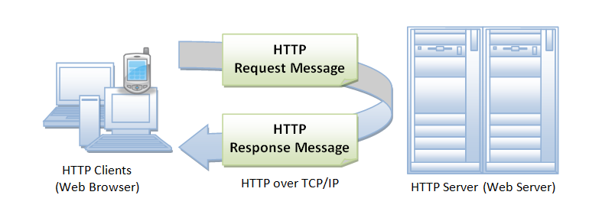

How
does
it
work?

Slide 10
HTTP
HTTP Messages
There are two types of HTTP messages, requests and responses, each with its own format.

Slide 11
HTTP
Requests
Requests consist of the following elements:
An HTTP method, usually a verb like GET, POST or a noun like OPTIONS or HEAD that defines the operation the client wants to perform. Typically, a client wants to fetch a resource (using GET) or post the value of an HTML form (using POST), though more operations may be needed in other cases.
The path of the resource to fetch; the URL of the resource stripped from elements that are obvious from the context, for example without the protocol (http://), the domain (here, developer.mozilla.org), or the TCP port (here, 80).
The version of the HTTP protocol.
Optional headers that convey additional information for the servers.
Or a body, for some methods like POST, similar to those in responses, which contain the resource sent.

Slide 12
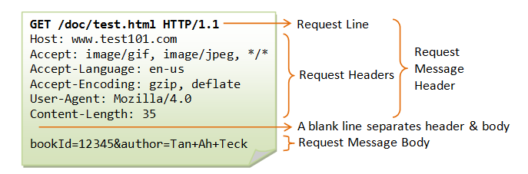
HTTP
Request example

Slide 13
HTTP
Responses
Responses consist of the following elements:
The version of the HTTP protocol they follow.
A status code, indicating if the request was successful, or not, and why.
A status message, a non-authoritative short description of the status code.
HTTP headers, like those for requests.
Optionally, a body containing the fetched resource.

Slide 14
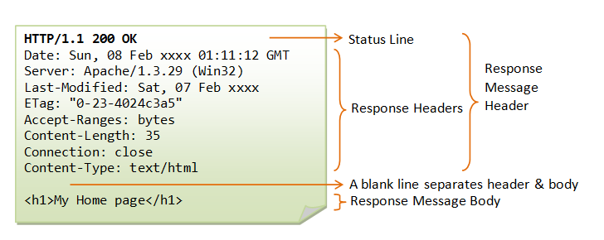
HTTP
Response example

Slide 15
Response Status Codes

Slide 16
HTTP
Response status codes
The first line of the response message contains the response status code, which is generated by the server to indicate the outcome of the request.
The status code is a 3-digit number:
1xx (Informational): Request received, server is continuing the process.
2xx (Success): The request was successfully received, understood, accepted and serviced.
3xx (Redirection): Further action must be taken in order to complete the request.
4xx (Client Error): The request contains bad syntax or cannot be understood.
5xx (Server Error): The server failed to fulfill an apparently valid request.

Slide 17
HTTP
Status codes examples
200 OK
The request is fulfilled
400 Bad Request
Server could not interpret or understand the request, probably syntax error in the request message.
301 Move Permanently
The resource requested for has been permanently moved to a new location.
401 Authentication Required
The requested resource is protected, and require client’s credential (username/password). The client should re-submit the request with his credential.
302 Found & Redirect (or Move Temporarily)
Same as 301, but the new location is temporarily moved to a new location. The client should issue a new request, but applications need not update the references.
403 Forbidden
Server refuses to supply the resource, regardless of identity of client.

Slide 18
HTTP
Status codes examples
404 Not Found
The requested resource cannot be found in the server.
500 Internal Server Error
Server is confused, often caused by an error in the server-side program responding to the request.
405 Method Not Allowed
The request method used, e.g., POST, PUT, DELETE, is a valid method. However, the server does not allow that method for the resource requested.
502 Bad Gateway
Proxy or Gateway indicates that it receives a bad response from the upstream server..
408 Request Timeout
503 Service Unavailable
Server cannot response due to overloading or maintenance. The client can try again later.

Slide 19
HTTP
Verbs
HTTP defines a set of request methods to indicate the desired action to be performed for a given resource. Although they can also be nouns, these request methods are sometimes referred to as HTTP verbs. Each of them implements a different semantic, but some common features are shared by a group of them: e.g. a request method can be safe, idempotent, or cacheable.
GET (Safe=Yes, Idempotent=Yes, Cacheable=Yes)
The GET method requests a representation of the specified resource. Requests using GET should only retrieve data.
HEAD (Safe=Yes, Idempotent=Yes, Cacheable=Yes)
Retrieving metadata about the resource, e.g. its media type or its size, before making a possibly costly retrieval
Checking whether a resource has changed. This is useful when maintaining a cached version of a resource

Slide 20
HTTP
Verbs
POST (Safe=No, Idempotent=No, Cacheable=Yes)
The POST method is used to submit an entity to the specified resource, often causing a change in state or side effects on the server.
PUT (Safe=No, Idempotent=Yes, Cacheable=No)
The PUT method replaces all current representations of the target resource with the request payload.
PATCH (Safe=No, Idempotent=No, Cacheable=No)
The PATCH method is used to apply partial modifications to a resource.
DELETE (Safe=No, Idempotent=Yes, Cacheable=No)
The DELETE method deletes the specified resource.

Slide 21
HTTP
Verbs
CONNECT
The CONNECT method establishes a tunnel to the server identified by the target resource.
TRACE
The TRACE method performs a message loop-back test along the path to the target resource.
OPTIONS*
Identifying which HTTP methods a resource supports, e.g. can we DELETE it or update it via a PUT?
* is actually a noun, not a verb

Slide 22
HTTP
Properties
SAFE
An HTTP method is safe if it doesn't alter the state of the server. In other words, a http method is safe if it leads to a read-only operation.
All safe methods are also idempotent, but not all idempotent methods are safe. For example, PUT and DELETE are both idempotent but unsafe.
Even if safe methods have a read-only semantic, servers can alter their state: e.g. they can log or keep statistics. By calling a safe method, the client doesn't request any server change itself, and therefore won't create an unnecessary load or burden for the server.
Browsers can call safe methods without fearing to cause any harm to the server;

Slide 23
HTTP
Properties
Idempotent
An HTTP method is idempotent if an identical request can be made once or several times in a row with the same effect while leaving the server in the same state. In other words, an idempotent method should not have any side-effects (except for keeping statistics).
Implemented correctly, the GET, HEAD, PUT, and DELETE methods are idempotent, but not the POST method. All safe methods are also idempotent.
*** The idempotence of a method is not guaranteed by the server and some applications may incorrectly break the idempotence constraint.

Slide 24
HTTP
Verbs properties
Idempotent
GET /pageX HTTP/1.1 is idempotent. Called several times in a row, the client gets the same results:
GET /pageX HTTP/1.1
GET /pageX HTTP/1.1
GET /pageX HTTP/1.1

Slide 25
HTTP
Verbs properties
POST /user HTTP/1.1 is not idempotent; if it is called several times, it adds several rows:
POST /user HTTP/1.1
POST /user HTTP/1.1 -> Adds a 2nd user
POST /user HTTP/1.1 -> Adds a 3rd user
DELETE /idX/delete HTTP/1.1 is idempotent, even if the returned status code may change between requests:
DELETE /user/123 HTTP/1.1 -> Returns 200 if user 123 exists
DELETE /user/123 HTTP/1.1 -> Returns 404 as it just got deleted
DELETE /user/123 HTTP/1.1 -> Returns 404

Slide 26
HTTP
Verbs properties
Cacheable
A cacheable response is an HTTP response that can be cached, that is stored to be retrieved and used later, saving a new request to the server. Not all HTTP responses can be cached, these are the following constraints for an HTTP response to be cached.
The method used in the request is itself cacheable, that is either a GET or a HEAD method. A response to a POST or PATCH request can also be cached if freshness is indicated and the Content-Location header is set, but this is rarely implemented.
Other methods, like PUT or DELETE are not cacheable and their result cannot be cached.
The status code of the response is known by the application caching, and it is considered cacheable. The following status code are cacheable: 200, 203, 204, 206, 300, 301, 404, 405, 410, 414, and 501.
There are specific headers in the response, like Cache-Control, that prevents caching.

Slide 27
Identify resources on web

Slide 28
HTTP
Resources on web
The target of an HTTP request is called a "resource": it can be a document, a photo, an object, or anything else. Each resource is identified by a Uniform Resource Identifier (URI) used throughout HTTP for identifying resources.
The identity and the location of resources on the Web are mostly given by a single URL
URL (Uniform Resource Locator)
The most common form of URI is the Uniform Resource Locator (URL), which is known as the web address ex: https://www.cognizantsoftvision.com/
URN (Uniform Resource Name)
It is a URI that identifies a resource by name in a particular namespace. ex: urn:isbn:9780141036144

Slide 29
Demo

Slide 30
SPRING MVC

Slide 31
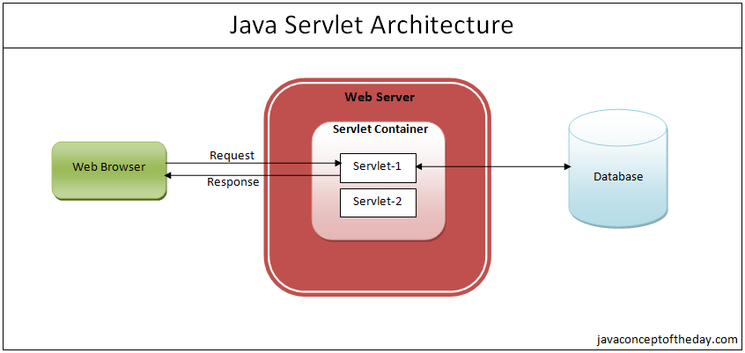
Java Servlet Specification
A servlet is a Java programming language class that is used to extend the capabilities of servers that host applications accessed by means of a request-response programming model. Although servlets can respond to any type of request, they are commonly used to extend the applications hosted by web servers.

Slide 32
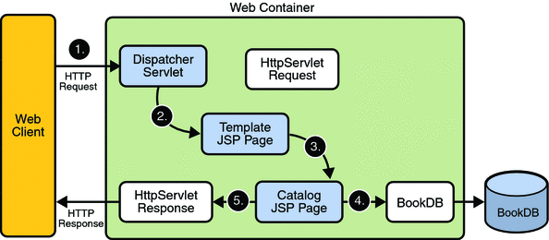
JSP
JavaServer Pages (JSP) is a Java standard technology that enables you to write dynamic, data-driven pages for your Java web applications. JSP is built on top of the Java Servlet specification.

Slide 33
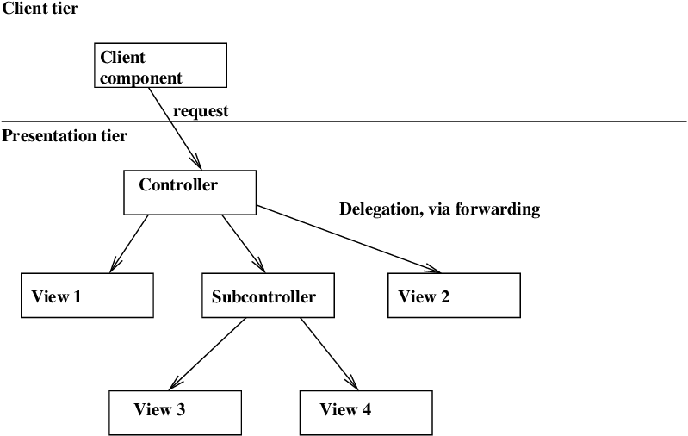
Front Controller Java Enterprise Pattern
The initial point of contact for handling a request. The controller manages the handling of the request, including invoking security services such as authentication and authorization, delegating business processing, managing the choice of an appropriate view, handling errors, and managing the selection of content creation strategies.

Slide 34
Spring MVC
Spring MVC helps in building flexible web applications.
The model-view-controller design pattern helps in separating the business logic, presentation logic, and navigation logic.
MODELS are responsible for encapsulating the application data.
VIEWS render a response to the user with the help of the model object.
CONTROLLERS are responsible for receiving the request from the user and calling the back-end services.

Slide 35
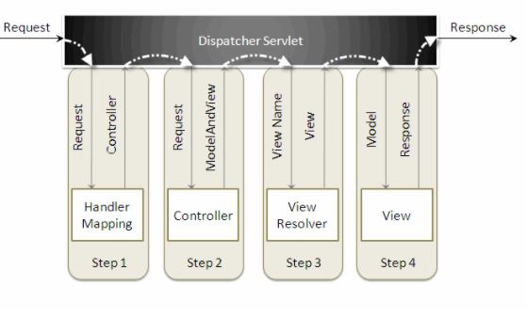
Spring MVC
How does it work?
When a request is sent to the Spring MVC framework the following sequence of events happen.
The dispatcherservlet first receives the request.
The dispatcherservlet consults the handlermapping and invokes the controller associated with the request.
The controller processes the request by calling the appropriate service methods and returns a modelandview object to the dispatcherservlet . the modelandview object contains the model data and the view name.
The dispatcherservlet sends the view name to a viewresolver to find the actual view to invoke.
Now, the dispatcherservlet will pass the model object to the view to render the result.
The view , with the help of the model data, will render the result back to the user.

Slide 36
SPRING MVC
DEMO

Slide 37
REST

Slide 38
REST
Representational State Transfer is often referred to as a protocol which defines how applications communicate over the Hypertext Transfer Protocol (HTTP).
Applications that use REST are loosely-coupled and transfer information quickly and efficiently.
While REST doesn’t define data formats, it’s usually associated with exchanging JSON or XML documents, as a resource representation between a client and a server.

Slide 39
JSON vs XML

Slide 40
JSON vs XML
JSON
JSON object has a type
JSON types: string, number, array, Boolean
Data is readily accessible as JSON objects
JSON is supported by most browsers
JSON has no display capabilities
JSON supports only text and number data type
It doesn't support comments
XML
XML data is typeless
All XML data should be string
XML data needs to be parsed.
Cross-browser XML parsing can be tricky
XML offers the capability to display data because it is a markup language.
JXML support various data types such as number, text, images, charts, graphs, etc.
Retrieving value is difficult
It supports comments.
XML documents are relatively more difficult to read and interpret.

Slide 41
JSON vs XML
{ "students": [
{ "id":"01",
"name": "Tom",
"lastname": "Price"
},
{ "id":"02",
"name": "Nick",
"lastname": "Thameson"
}
]
}
<?xml version="1.0" encoding="UTF-8" ?>
<students>
<student>
<id>01</id>
<name>Tom</name>
<lastname>Price</lastname>
</student>
<student>
<id>02</id>
<name>Nick</name>
<lastname>Thameson</lastname>
</student>
</root>

Slide 42
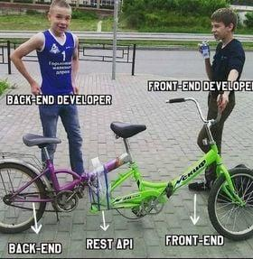
REST API

Slide 43
Spring MVC Annotations

Slide 44
Annotations
Component
@Component tells to Spring to automatically detect our custom beans
During the first Spring release, all beans used to be declared in an XML file. For a large project, this quickly becomes a massive task, and Spring guys recognized the problem quickly.
In later versions, they provide annotation-based dependency injection and Java-based configuration. From Spring 2.5 annotation-based dependency injection was introduced, which automatically scans and registers classes as Spring bean which is annotated using @Component annotation.
This means you don’t declare that bean using the <bean> tag and inject the dependency, it will be done automatically by Spring. This functionality was enabled and disabled using <context:component-scan> tag.

Slide 45
Annotations
@Service, @Controller, and @Repository
Specialized annotations of @Component for certain situations
By using that annotation we do two things: first, we declare that this class is a Spring bean and should be created and maintained by Spring ApplicationContext, but also we indicate that its role.
This 2nd property is used by web-specific tools and functionalities. For example, DispatcherServlet will look for @RequestMapping on classes that are annotated using @Controller but not with @Component.
This means @Component and @Controller are the same with respect to bean creation and dependency injection but later is a specialized form of former. Even if you replace @Controller annotation with @Component, Spring can automatically detect and register the controller class but it may not work as you expect with respect to request mapping.

Slide 46
Annotations
Rest Controller
@RestController= @Controller + @ResponseBody; it is used to define the RESTful web services. It serves JSON, XML and custom response.
@RestController
public class UserController{}
Request Mapping
@RequestMapping is used to define the Request URI to access the REST Endpoints. We can define Request method to consume and produce object. The default request method is GET. (@GetMapping @PostMapping)
@RequestMapping(value = "/user")
public ResponseEntity<User> getUsers() { }
Request Body
@RequestBody annotation is used to define the request body content type.
public ResponseEntity<User> createUser(@RequestBody User user) {
}

Slide 47
Annotations
Path Variable
@PathVariable annotation is used to define the custom url: ex http://localhost:8080/api/users/111
@GetMapping("/api/users/{id}")
@ResponseBody
public String getUserById(@PathVariable String id) {
return "ID: " + id;
}
Request Parameter
@RequestParam annotation is used to read the request parameters from the Request URL. ex http://localhost:8080/users?id=111
@GetMapping("/users")
@ResponseBody
public String getUserByIdUsingQueryParam(@RequestParam String id) {
return "ID: " + id;
}

Slide 48

Annotations
Best practices
@PathVariable or @RequestParam?

Slide 49
Exception Handling
EmployeeNotFoundException is an exception used to indicate when an employee is looked up but not found.
class EmployeeNotFoundException extends RuntimeException {
EmployeeNotFoundException(Long id) {
super("Could not find employee " + id);
}
}
When an EmployeeNotFoundException is thrown, we need an extra bit of Spring MVC configuration to render a HTTP 404 response

Slide 50
Exception Handling
@ControllerAdvice
class EmployeeNotFoundAdvice {
@ResponseBody
@ExceptionHandler(EmployeeNotFoundException.class)
@ResponseStatus(HttpStatus.NOT_FOUND)
String employeeNotFoundHandler(EmployeeNotFoundException ex) {
return ex.getMessage();
}
}
@ResponseBody signals that this advice is rendered straight into the response body.
@ExceptionHandler configures the advice to only respond if an EmployeeNotFoundException is thrown.
@ResponseStatus says to issue an HttpStatus.NOT_FOUND, i.e. an HTTP 404.
The body of the advice generates the content. In this case, it gives the message of the exception.

Slide 51
Postman tool

Slide 52
Spring Rest API demo

Slide 53
Time for practice

Slide 54
Lab exercises
Using the browser console find 5 different HTTP Status Codes in some responded on a website (or more websites)
Implement an Update and a Partial Update for a resource in your Spring application
Return all posts added by the current user.
Create a custom exception. Based on that exception return an appropriate HTTP response

